Slide 1
Chapter 1
생물이란?
Introduction: Biology Today

Slide 2
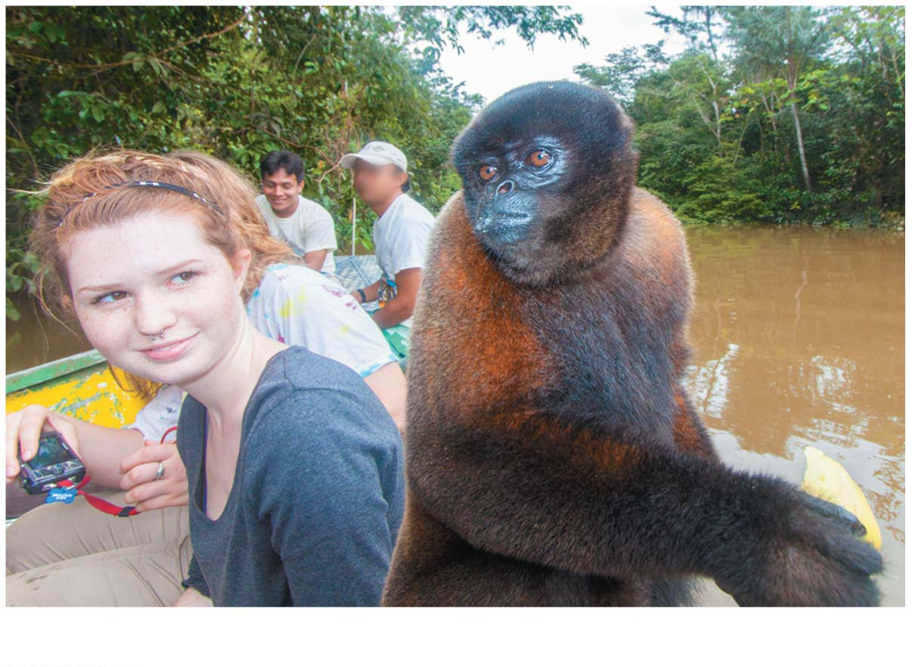
Biology and Society: An Innate Passion for Life
Most of us have an inherent interest in life, an inborn curiosity of the natural world that leads us to explore and study animals and plants and their habitats.
Life is relevant and important to you, no matter your background or goals.
The subject of biology is woven into the fabric of society.
Biology All Around Us
Notes:
2

Slide 3
Science is an approach to understanding the natural world that is based on inquiry:
a search for information,
explanations, and
answers to specific questions.
Biology is the scientific study of life.
Two main scientific approaches:
discovery science, which is mostly about describing nature, and
Hypothesis가설-driven science, which is mostly about explaining nature.
Most scientists practice a combination of these two forms of inquiry.
Notes:
3
Student Misconceptions and Concerns
1. Contrasting the concept of faith with the tentative nature of science can help to define and distinguish science from other ways of knowing. Students sometimes enter science classes expecting absolutes of facts and rigid dogma. Instead, scientific knowledge is tentative, reflecting degrees of confidence closely correlated to the strength of the evidence.
2. The authors’ distinction between natural and supernatural explanations is essential to understanding the power and limits of scientific explanations.
3. Some students think that variables are somehow restricted in a controlled experiment. That is, everything about the experiment is “controlled.” But controlled experiments limit the differences between experimental and control groups, with only one difference in most situations. That way, when a difference between the groups is identified, it can be explained by the single difference between the groups.
4. The common use of the terms law and theory by the public often blurs the stricter definitions of these terms in science. In general, laws describe and theories explain. Both are typically well-established concepts in science. A free online publication by the National Academy of Sciences helps to define these and related terms more carefully. See Chapter 1 of Teaching about Evolution and the Nature of Science at www.nap.edu/openbook.php?record_id=5787.
Teaching Tips
1. Consider using a laboratory exercise to have your students plan and perhaps conduct investigations using discovery science and a hypothesis-driven approach. Emphasize the processes and not the significance of the questions. Students can conduct descriptive surveys of student behavior (e.g., use of pens, pencils, or electronic devices for taking notes) or test hypotheses using controlled trials. Students may need considerable supervision and advice while planning and conducting their experiments.
Active Lecture Tips
1. Consider presenting your class with several descriptions of scientific investigations. Then ask students to categorize each type of experiment as discovery science or hypothesis-driven science. If students can work in small groups, encourage quick discussions to clarify these two types of scientific investigations.
2. You might also present to your class descriptions of several scientific investigations that you have written. Include in your descriptions numerous examples of improper methodology (small sample size, several variables existing between the control and experimental groups, failure to specifically test the hypothesis, and the like). Let small groups or individuals analyze the experiments in class to identify the flaws. This critical analysis allows students the opportunity to suggest the characteristics of good investigations in class.
3. Have your students turn to a few other students seated nearby to explain why a coordinated conspiracy promoting a specific idea in science is unlikely to succeed. Have your students describe aspects of science that would check fraudulent or erroneous claims and/or political efforts.
4. See the Activity Practicing the Scientific Method: Are Girls Better Than Boys at Some Tasks? on the Instructor Exchange. Visit the Instructor Exchange in the MasteringBiology instructor resource area for a description of this activity.

Slide 4
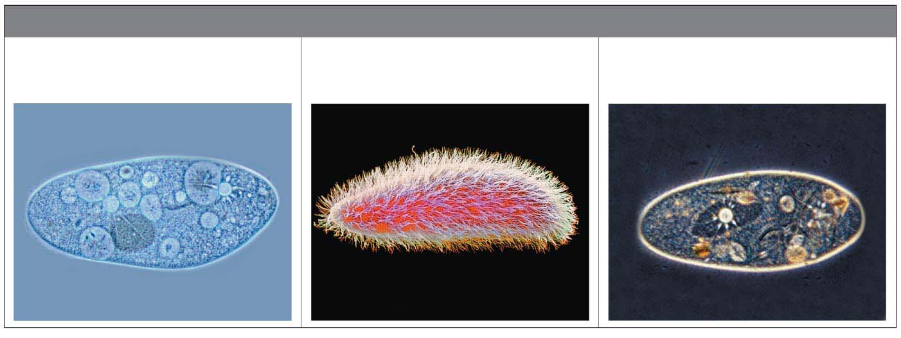
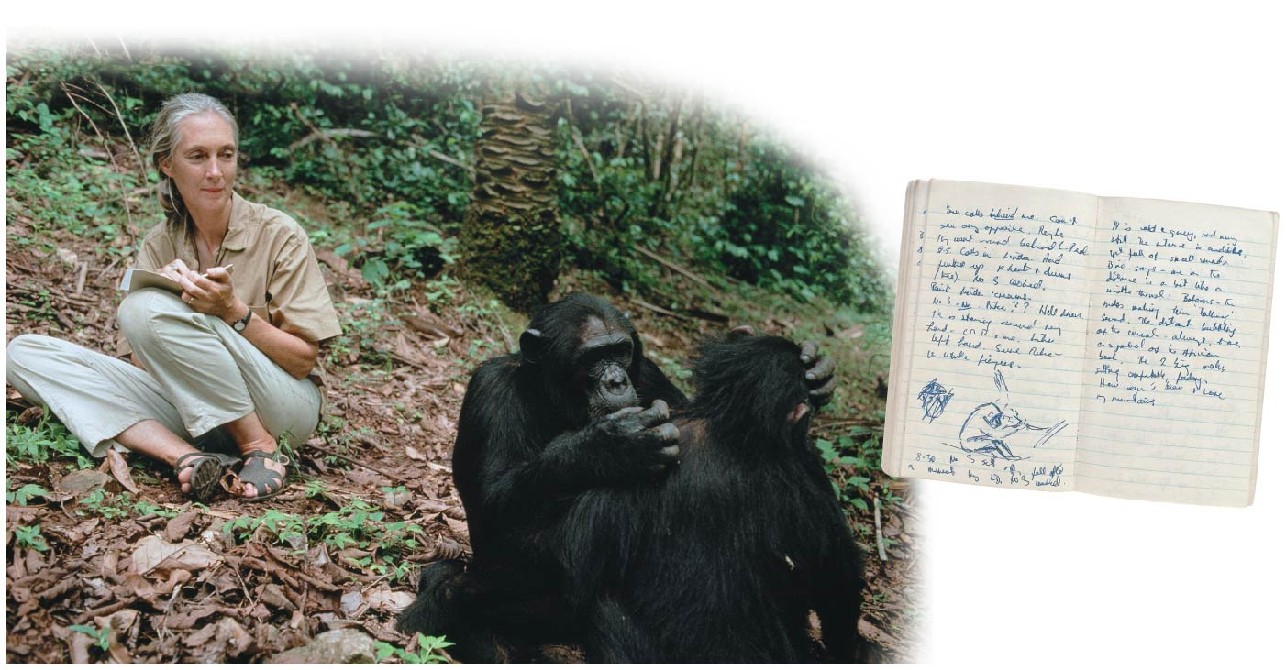
data
TYPES OF MICROGRAPHS
Light Micrograph (LM)
Scanning Electron
Micrograph (SEM)
Transmission Electron
Micrograph (TEM)
Jane Goodall
with
chimpanzees
living in
the jungles
of Tanzania.
Notes:
Figure 1.1 The protist Paramecium viewed with three different types of microscopes

Slide 5
Hypothesis-Driven Science
Most modern scientific investigations can be described as hypothesis-driven science.
A hypothesis is
a tentative answer to a question or
a proposed explanation for a set of observations.
Once a hypothesis is formed, an investigator can make predictions about what results are expected if that hypothesis is correct.
We then test the hypothesis by performing an experiment to see whether or not the results are as predicted.
A good hypothesis immediately leads to predictions that can be tested by experiments.
Notes:
5
Student Misconceptions and Concerns
1. Contrasting the concept of faith with the tentative nature of science can help to define and distinguish science from other ways of knowing. Students sometimes enter science classes expecting absolutes of facts and rigid dogma. Instead, scientific knowledge is tentative, reflecting degrees of confidence closely correlated to the strength of the evidence.
2. The authors’ distinction between natural and supernatural explanations is essential to understanding the power and limits of scientific explanations.
3. Some students think that variables are somehow restricted in a controlled experiment. That is, everything about the experiment is “controlled.” But controlled experiments limit the differences between experimental and control groups, with only one difference in most situations. That way, when a difference between the groups is identified, it can be explained by the single difference between the groups.
4. The common use of the terms law and theory by the public often blurs the stricter definitions of these terms in science. In general, laws describe and theories explain. Both are typically well-established concepts in science. A free online publication by the National Academy of Sciences helps to define these and related terms more carefully. See Chapter 1 of Teaching about Evolution and the Nature of Science at www.nap.edu/openbook.php?record_id=5787.
Teaching Tips
1. Consider using a laboratory exercise to have your students plan and perhaps conduct investigations using discovery science and a hypothesis-driven approach. Emphasize the processes and not the significance of the questions. Students can conduct descriptive surveys of student behavior (e.g., use of pens, pencils, or electronic devices for taking notes) or test hypotheses using controlled trials. Students may need considerable supervision and advice while planning and conducting their experiments.
Active Lecture Tips
1. Consider presenting your class with several descriptions of scientific investigations. Then ask students to categorize each type of experiment as discovery science or hypothesis-driven science. If students can work in small groups, encourage quick discussions to clarify these two types of scientific investigations.
2. You might also present to your class descriptions of several scientific investigations that you have written. Include in your descriptions numerous examples of improper methodology (small sample size, several variables existing between the control and experimental groups, failure to specifically test the hypothesis, and the like). Let small groups or individuals analyze the experiments in class to identify the flaws. This critical analysis allows students the opportunity to suggest the characteristics of good investigations in class.
3. Have your students turn to a few other students seated nearby to explain why a coordinated conspiracy promoting a specific idea in science is unlikely to succeed. Have your students describe aspects of science that would check fraudulent or erroneous claims and/or political efforts.
4. See the Activity Practicing the Scientific Method: Are Girls Better Than Boys at Some Tasks? on the Instructor Exchange. Visit the Instructor Exchange in the MasteringBiology instructor resource area for a description of this activity.

Slide 6
Scientific investigations are not the only way of knowing nature.
Science and religion are two very different ways of trying to make sense of nature.
Art is yet another way to make sense of the world around us.
Science can neither prove nor disprove that angels, ghosts, deities, or spirits, whether benevolent or evil, cause storms, eclipses, illnesses, or cure diseases, because such explanations are not measurable and are therefore outside the bounds of science.
A broad education should include exposure to all these different ways of viewing the world.
Notes:
6
Student Misconceptions and Concerns
1. Contrasting the concept of faith with the tentative nature of science can help to define and distinguish science from other ways of knowing. Students sometimes enter science classes expecting absolutes of facts and rigid dogma. Instead, scientific knowledge is tentative, reflecting degrees of confidence closely correlated to the strength of the evidence.
2. The authors’ distinction between natural and supernatural explanations is essential to understanding the power and limits of scientific explanations.
3. Some students think that variables are somehow restricted in a controlled experiment. That is, everything about the experiment is “controlled.” But controlled experiments limit the differences between experimental and control groups, with only one difference in most situations. That way, when a difference between the groups is identified, it can be explained by the single difference between the groups.
4. The common use of the terms law and theory by the public often blurs the stricter definitions of these terms in science. In general, laws describe and theories explain. Both are typically well-established concepts in science. A free online publication by the National Academy of Sciences helps to define these and related terms more carefully. See Chapter 1 of Teaching about Evolution and the Nature of Science at www.nap.edu/openbook.php?record_id=5787.
Teaching Tips
1. Consider using a laboratory exercise to have your students plan and perhaps conduct investigations using discovery science and a hypothesis-driven approach. Emphasize the processes and not the significance of the questions. Students can conduct descriptive surveys of student behavior (e.g., use of pens, pencils, or electronic devices for taking notes) or test hypotheses using controlled trials. Students may need considerable supervision and advice while planning and conducting their experiments.
Active Lecture Tips
1. Consider presenting your class with several descriptions of scientific investigations. Then ask students to categorize each type of experiment as discovery science or hypothesis-driven science. If students can work in small groups, encourage quick discussions to clarify these two types of scientific investigations.
2. You might also present to your class descriptions of several scientific investigations that you have written. Include in your descriptions numerous examples of improper methodology (small sample size, several variables existing between the control and experimental groups, failure to specifically test the hypothesis, and the like). Let small groups or individuals analyze the experiments in class to identify the flaws. This critical analysis allows students the opportunity to suggest the characteristics of good investigations in class.
3. Have your students turn to a few other students seated nearby to explain why a coordinated conspiracy promoting a specific idea in science is unlikely to succeed. Have your students describe aspects of science that would check fraudulent or erroneous claims and/or political efforts.
4. See the Activity Practicing the Scientific Method: Are Girls Better Than Boys at Some Tasks? on the Instructor Exchange. Visit the Instructor Exchange in the MasteringBiology instructor resource area for a description of this activity.

Slide 7
Theories in Science
What is a scientific theory, and how is it different from a hypothesis?
A scientific theory(학)설 is much broader in scope than a hypothesis.
A theory
is a comprehensive explanation supported by abundant evidence, and
is general enough to spin off many new testable hypotheses.
People like Isaac Newton, Charles Darwin, and Albert Einstein stand out in the history of science not because they discovered a great many facts but because their theories had such broad explanatory power.
Notes:
7
Student Misconceptions and Concerns
1. Contrasting the concept of faith with the tentative nature of science can help to define and distinguish science from other ways of knowing. Students sometimes enter science classes expecting absolutes of facts and rigid dogma. Instead, scientific knowledge is tentative, reflecting degrees of confidence closely correlated to the strength of the evidence.
2. The authors’ distinction between natural and supernatural explanations is essential to understanding the power and limits of scientific explanations.
3. Some students think that variables are somehow restricted in a controlled experiment. That is, everything about the experiment is “controlled.” But controlled experiments limit the differences between experimental and control groups, with only one difference in most situations. That way, when a difference between the groups is identified, it can be explained by the single difference between the groups.
4. The common use of the terms law and theory by the public often blurs the stricter definitions of these terms in science. In general, laws describe and theories explain. Both are typically well-established concepts in science. A free online publication by the National Academy of Sciences helps to define these and related terms more carefully. See Chapter 1 of Teaching about Evolution and the Nature of Science at www.nap.edu/openbook.php?record_id=5787.
Teaching Tips
1. Consider using a laboratory exercise to have your students plan and perhaps conduct investigations using discovery science and a hypothesis-driven approach. Emphasize the processes and not the significance of the questions. Students can conduct descriptive surveys of student behavior (e.g., use of pens, pencils, or electronic devices for taking notes) or test hypotheses using controlled trials. Students may need considerable supervision and advice while planning and conducting their experiments.
Active Lecture Tips
1. Consider presenting your class with several descriptions of scientific investigations. Then ask students to categorize each type of experiment as discovery science or hypothesis-driven science. If students can work in small groups, encourage quick discussions to clarify these two types of scientific investigations.
2. You might also present to your class descriptions of several scientific investigations that you have written. Include in your descriptions numerous examples of improper methodology (small sample size, several variables existing between the control and experimental groups, failure to specifically test the hypothesis, and the like). Let small groups or individuals analyze the experiments in class to identify the flaws. This critical analysis allows students the opportunity to suggest the characteristics of good investigations in class.
3. Have your students turn to a few other students seated nearby to explain why a coordinated conspiracy promoting a specific idea in science is unlikely to succeed. Have your students describe aspects of science that would check fraudulent or erroneous claims and/or political efforts.
4. See the Activity Practicing the Scientific Method: Are Girls Better Than Boys at Some Tasks? on the Instructor Exchange. Visit the Instructor Exchange in the MasteringBiology instructor resource area for a description of this activity.

Slide 8
The Nature of Life
What is life?
What distinguishes living things from nonliving things?
The phenomenon of life생명 seems to defy a simple, one-sentence definition.
We recognize life mainly by what living things do.
Notes:
8
Student Misconceptions and Concerns
1. We live in a world that is largely understood by what we can distinguish and identify with our naked senses. However, the diversity of life and the levels of biological organization extend well beyond the physical scale of our daily lives. For many students, appreciating the diversity of the microscopic world is abstract, nearly on par with an understanding of the workings of atoms and molecules. A laboratory opportunity to examine the microscopic details of objects from our daily lives (the surface of potato chips, the structure of table salt and sugar, the details of a blade of grass) can be an important sensory extension that prepares the mind for greater comprehension of these minute biological details.
Teaching Tips
1. Consider asking students to bring to class a page or two of an article about biology that appeared in the media in the last month. Alternatively, you could have each student email a Web address of a recent biology-related news event to you. You might even have them e-mail relevant articles to you for each of the main topics you address throughout the semester.
2. Here is a simple way to contrast the relative size of prokaryotic and eukaryotic cells. Mitochondria and chloroplasts are thought to have evolved by endosymbiosis. Thus, mitochondria and chloroplasts are about the size of bacteria, contained within a plant cell. A figure of a plant cell therefore provides an immediate comparison of these sizes, not side-by-side, but one inside the other!
3. The scientific organization Sigma Xi offers a free summary of the major science news articles each weekday. The first few paragraphs of each article are included with a hyperlink to the source of the entire article. The topics are diverse and can be an excellent way to be aware of daily scientific announcements and reports. Typically, about ten articles are cited each weekday. Science in the News is part of the website www.americanscientist.org/, where you can sign up for a free newsletter each weekday.
4. An excellent introduction to the domains and kingdoms of life is presented at www.ucmp.berkeley.edu/exhibits/historyoflife.php.
Active Lecture Tips
1. Ask your students, at the start of the semester, to write down the first type of animal that comes to mind. The most frequent response is a mammal. (In my courses, over a 25-year period, more than 98% of the examples have been mammals.) As the diversity of life is explored, the common heritage of biological organization can be less, and not more, apparent. The diverse forms, habits, and ecological interactions overwhelm our senses with differences. Emphasizing the diversity and unifying aspects of life is necessary for a greater understanding of the evolutionary history of life on Earth.
2. Consider asking students to pair up with someone sitting near them to identify examples of the seven properties of life in some organism from your region (or perhaps a school mascot, if appropriate).

Slide 9
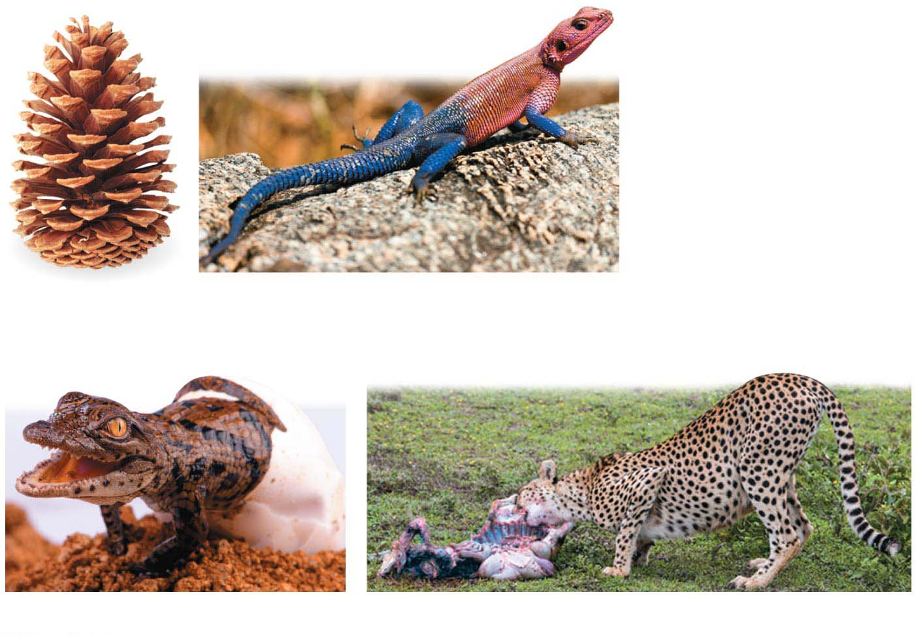
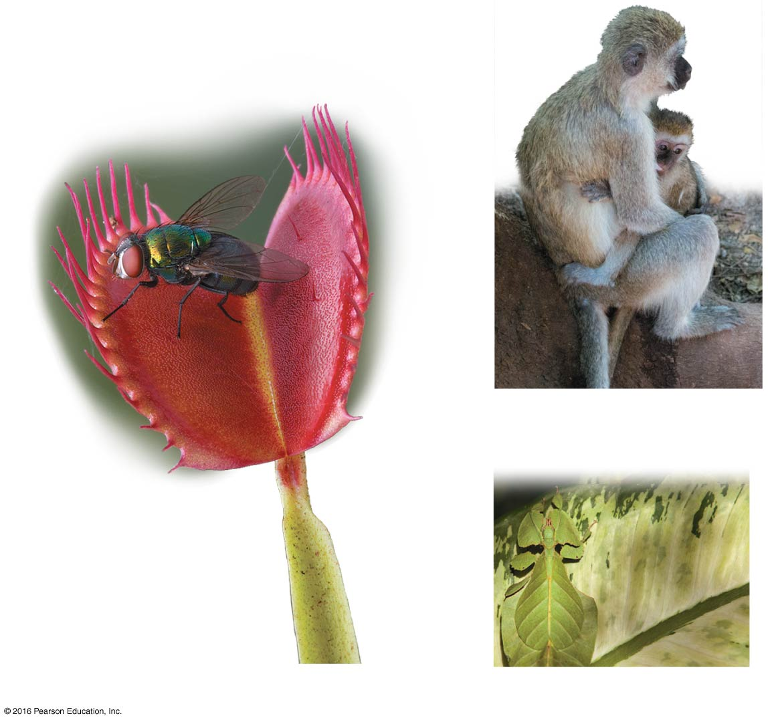
Figure 1.4-1
(a) Order
(b) Regulation
(f) Reproduction
(c) Growth and development
(d) Energy processing
(e) Response to the environment
(g) Evolution
Notes:
Figure 1.4-1 Some properties of life (part 1)

Slide 10
Life in Its Diverse Forms
The diversity of known life—all the species that have been identified and named—includes
at least 290,000 plants,
52,000 vertebrates (animals with backbones), and
1 million insects (more than half of all known forms of life).
Biologists add thousands of newly identified species to the list each year.
Estimates of the total number of species range from 10 million to more than 100 million.
Notes:
10
Student Misconceptions and Concerns
1. We live in a world that is largely understood by what we can distinguish and identify with our naked senses. However, the diversity of life and the levels of biological organization extend well beyond the physical scale of our daily lives. For many students, appreciating the diversity of the microscopic world is abstract, nearly on par with an understanding of the workings of atoms and molecules. A laboratory opportunity to examine the microscopic details of objects from our daily lives (the surface of potato chips, the structure of table salt and sugar, the details of a blade of grass) can be an important sensory extension that prepares the mind for greater comprehension of these minute biological details.
Teaching Tips
1. Consider asking students to bring to class a page or two of an article about biology that appeared in the media in the last month. Alternatively, you could have each student email a Web address of a recent biology-related news event to you. You might even have them e-mail relevant articles to you for each of the main topics you address throughout the semester.
2. Here is a simple way to contrast the relative size of prokaryotic and eukaryotic cells. Mitochondria and chloroplasts are thought to have evolved by endosymbiosis. Thus, mitochondria and chloroplasts are about the size of bacteria, contained within a plant cell. A figure of a plant cell therefore provides an immediate comparison of these sizes, not side-by-side, but one inside the other!
3. The scientific organization Sigma Xi offers a free summary of the major science news articles each weekday. The first few paragraphs of each article are included with a hyperlink to the source of the entire article. The topics are diverse and can be an excellent way to be aware of daily scientific announcements and reports. Typically, about ten articles are cited each weekday. Science in the News is part of the website www.americanscientist.org/, where you can sign up for a free newsletter each weekday.
4. An excellent introduction to the domains and kingdoms of life is presented at www.ucmp.berkeley.edu/exhibits/historyoflife.php.
Active Lecture Tips
1. Ask your students, at the start of the semester, to write down the first type of animal that comes to mind. The most frequent response is a mammal. (In my courses, over a 25-year period, more than 98% of the examples have been mammals.) As the diversity of life is explored, the common heritage of biological organization can be less, and not more, apparent. The diverse forms, habits, and ecological interactions overwhelm our senses with differences. Emphasizing the diversity and unifying aspects of life is necessary for a greater understanding of the evolutionary history of life on Earth.
2. Consider asking students to pair up with someone sitting near them to identify examples of the seven properties of life in some organism from your region (or perhaps a school mascot, if appropriate).

Slide 11
Grouping Species: The Basic Concept
To make sense of nature, people tend to group diverse items according to similarities.
A species종 is generally defined as a group of organisms that
live in the same place and time and
have the potential to interbreed with one another in nature to produce healthy offspring.
Taxonomy분류학, the branch of biology that names and classifies species, is the arrangement of species into a hierarchy of broader and broader groups.
Notes:
11
Student Misconceptions and Concerns
1. We live in a world that is largely understood by what we can distinguish and identify with our naked senses. However, the diversity of life and the levels of biological organization extend well beyond the physical scale of our daily lives. For many students, appreciating the diversity of the microscopic world is abstract, nearly on par with an understanding of the workings of atoms and molecules. A laboratory opportunity to examine the microscopic details of objects from our daily lives (the surface of potato chips, the structure of table salt and sugar, the details of a blade of grass) can be an important sensory extension that prepares the mind for greater comprehension of these minute biological details.
Teaching Tips
1. Consider asking students to bring to class a page or two of an article about biology that appeared in the media in the last month. Alternatively, you could have each student email a Web address of a recent biology-related news event to you. You might even have them e-mail relevant articles to you for each of the main topics you address throughout the semester.
2. Here is a simple way to contrast the relative size of prokaryotic and eukaryotic cells. Mitochondria and chloroplasts are thought to have evolved by endosymbiosis. Thus, mitochondria and chloroplasts are about the size of bacteria, contained within a plant cell. A figure of a plant cell therefore provides an immediate comparison of these sizes, not side-by-side, but one inside the other!
3. The scientific organization Sigma Xi offers a free summary of the major science news articles each weekday. The first few paragraphs of each article are included with a hyperlink to the source of the entire article. The topics are diverse and can be an excellent way to be aware of daily scientific announcements and reports. Typically, about ten articles are cited each weekday. Science in the News is part of the website www.americanscientist.org/, where you can sign up for a free newsletter each weekday.
4. An excellent introduction to the domains and kingdoms of life is presented at www.ucmp.berkeley.edu/exhibits/historyoflife.php.
Active Lecture Tips
1. Ask your students, at the start of the semester, to write down the first type of animal that comes to mind. The most frequent response is a mammal. (In my courses, over a 25-year period, more than 98% of the examples have been mammals.) As the diversity of life is explored, the common heritage of biological organization can be less, and not more, apparent. The diverse forms, habits, and ecological interactions overwhelm our senses with differences. Emphasizing the diversity and unifying aspects of life is necessary for a greater understanding of the evolutionary history of life on Earth.
2. Consider asking students to pair up with someone sitting near them to identify examples of the seven properties of life in some organism from your region (or perhaps a school mascot, if appropriate).

Slide 12
The Three Domains of Life
The three domains of life are
Bacteria세균,
Archaea고세균, and
Eukarya진핵생물.
Bacteria and Archaea have prokaryotic cells.
Eukarya have eukaryotic cells.
Notes:
12
Student Misconceptions and Concerns
1. We live in a world that is largely understood by what we can distinguish and identify with our naked senses. However, the diversity of life and the levels of biological organization extend well beyond the physical scale of our daily lives. For many students, appreciating the diversity of the microscopic world is abstract, nearly on par with an understanding of the workings of atoms and molecules. A laboratory opportunity to examine the microscopic details of objects from our daily lives (the surface of potato chips, the structure of table salt and sugar, the details of a blade of grass) can be an important sensory extension that prepares the mind for greater comprehension of these minute biological details.
Teaching Tips
1. Consider asking students to bring to class a page or two of an article about biology that appeared in the media in the last month. Alternatively, you could have each student email a Web address of a recent biology-related news event to you. You might even have them e-mail relevant articles to you for each of the main topics you address throughout the semester.
2. Here is a simple way to contrast the relative size of prokaryotic and eukaryotic cells. Mitochondria and chloroplasts are thought to have evolved by endosymbiosis. Thus, mitochondria and chloroplasts are about the size of bacteria, contained within a plant cell. A figure of a plant cell therefore provides an immediate comparison of these sizes, not side-by-side, but one inside the other!
3. The scientific organization Sigma Xi offers a free summary of the major science news articles each weekday. The first few paragraphs of each article are included with a hyperlink to the source of the entire article. The topics are diverse and can be an excellent way to be aware of daily scientific announcements and reports. Typically, about ten articles are cited each weekday. Science in the News is part of the website www.americanscientist.org/, where you can sign up for a free newsletter each weekday.
4. An excellent introduction to the domains and kingdoms of life is presented at www.ucmp.berkeley.edu/exhibits/historyoflife.php.
Active Lecture Tips
1. Ask your students, at the start of the semester, to write down the first type of animal that comes to mind. The most frequent response is a mammal. (In my courses, over a 25-year period, more than 98% of the examples have been mammals.) As the diversity of life is explored, the common heritage of biological organization can be less, and not more, apparent. The diverse forms, habits, and ecological interactions overwhelm our senses with differences. Emphasizing the diversity and unifying aspects of life is necessary for a greater understanding of the evolutionary history of life on Earth.
2. Consider asking students to pair up with someone sitting near them to identify examples of the seven properties of life in some organism from your region (or perhaps a school mascot, if appropriate).

Slide 13
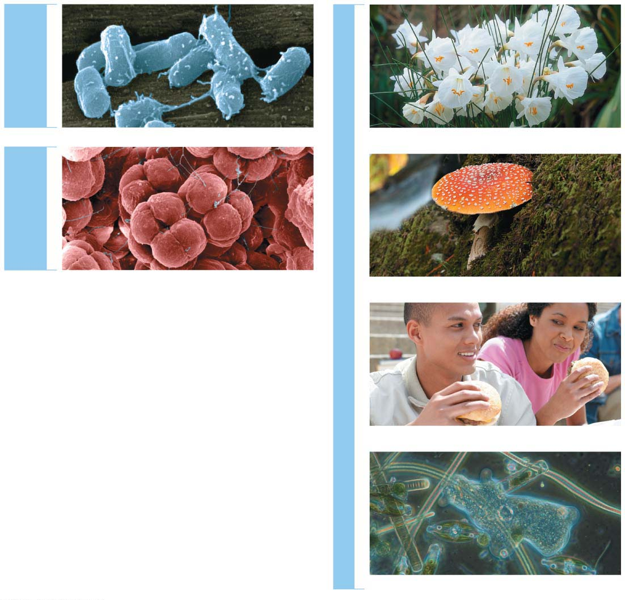
Figure 1.7
DOMAIN
BACTERIA
Kingdom Plantae
DOMAIN
ARCHAEA
DOMAIN EUKARYA
Kingdom Fungi
Those eukaryotes that do not fit into any of the three kingdoms fall into a catch-all group called the protists.
Most protists are single-celled; they include microscopic organisms such as amoebas.
But protists also include certain multicellular forms, such as seaweeds.
Scientists are in the process of organizing protists into multiple kingdoms, although they do not yet agree on exactly how to do this.
Kingdom Animalia
Protists (multiple kingdoms)
Notes:
Figure 1.7 The three domains of life

Slide 14
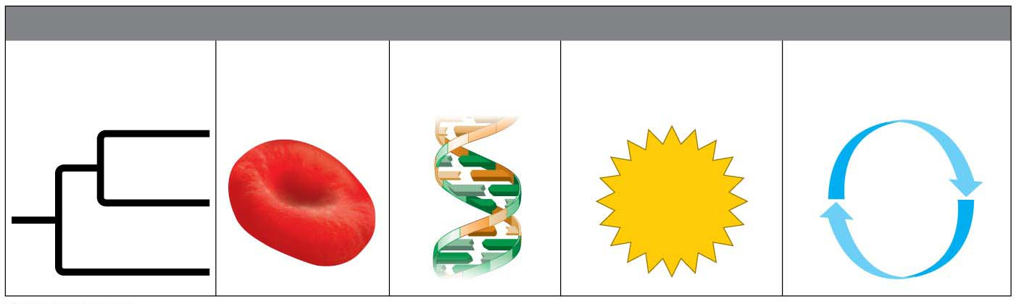
Figure 1.8
Major Themes in Biology
MAJOR THEMES IN BIOLOGY
Structure/
Function
Information
Flow
Energy
Transformations
Interconnections
within Systems
Evolution
Notes:
Figure 1.8 Five unifying themes that run throughout the discipline of biology

Slide 15
Evolution진화
Evolution is
the fundamental principle of life and
the core theme that unifies all of biology.
The theory of evolution by natural selection, first described by Charles Darwin more than 150 years ago, is the one idea that makes sense of everything we know about living organisms.
Notes:
15
Student Misconceptions and Concerns
1. Students often believe that Charles Darwin was the first to suggest that life evolves; the early contributions by Greek philosophers and the work of Jean-Baptiste Lamarck may be unappreciated. Consider emphasizing this earlier work in your introduction to Darwin’s contributions.
2. Students often misunderstand the basic process of evolution and instead reflect a Lamarckian point of view. Organisms do not evolve structures deliberately or out of want or need. Individuals do not evolve. Evolution is a passive process in which the environment favors one or more existing variations of a trait already present in a population.
Teaching Tips
1. Many resources related to Charles Darwin are available on the Internet:
a. General evolution resources:
evolution.berkeley.edu
nationalacademies.org/evolution
ncse.com
b. The complete works of Charles Darwin can be found at darwin-online.org.uk/
c. Details of Charles Darwin’s home are located at http://williamcalvin.com/bookshelf/down_hse.htm
2. There are many variations of games that model aspects of natural selection. Here is one that is appropriate for a laboratory exercise. Purchase several bags of dried grocery store beans of diverse sizes and colors. Large lima beans, small white beans, red beans, and black beans are all good options. Consider the beans “food” for the “predatory” students. To begin, randomly distribute (throw) 100 beans of each of four colors onto a green lawn. Allow individual students to collect beans over a set period, perhaps 3 minutes. Then count the total number of each color of bean collected. Assume that the beans remaining undetected (still in the lawn) reproduce by doubling in number. Calculate the number of beans of each color remaining in the field. For the next round, count out the number of each color to add to the lawn so that the new totals on the lawn will double the number of beans that students did not find in the first “generation.” Before each predatory episode, record the total number of each color of beans that have “survived” in the field. Then let your student “predators” out for another round of collection (generation). Repeat the process for at least three or four “generations.” Note what colors of beans are favored by the environment. Ask students to speculate which colors might have been favored during another season or on a parking lot.
3. Many websites devoted to domesticated species can be used to illustrate the variety of forms produced by artificial selection. Those devoted to pigeons, chickens, and dogs have proven to be especially useful.
4. The authors make an analogy between the four bases used to form genes and the 26 letters of the English alphabet used to create words and sentences. One could also make an analogy between the four bases and trains composed of four different types of railroad cars (perhaps an engine, boxcar, tanker, and flatcar). Imagine how many different types of trains one could make using just 100 rail cars of four different types. (The answer is 4¹⁰⁰.)
5. For a chance to add a little math to the biological levels of organization, consider calculating the general scale differences between each level of biological organization. For example, are cells generally 5, 10, 50, or 100 times more massive than organelles? Are organelles generally 5, 10, 50, or 100 times more massive than macromolecules? For some levels of organization, such as ecosystems, communities, and populations, size or scale differences are perhaps less relevant and more problematic to consider. However, at the smaller levels, the sense of scale might enhance an appreciation for levels of biological organization.
6. The U.S. Census Bureau maintains updated population clocks that estimate the U.S. and world populations (www.census.gov/popclock/). If students have a general idea of the human population of the United States, statistics about the number of people affected with a disease or disaster become more significant. For example, the current population of the United States is about 320,000,000 (in 2014). It is currently estimated that at least 1 million people in the United States are infected with HIV. The number of people infected with HIV is impressive and concerning, but not perhaps as meaningful as the realization that this represents about one of every 320 people in the United States. Although the infected people are not evenly distributed among geographic and ethnic groups, if you apply this generality to the enrollments in your classes, the students might better understand the tremendous impact of HIV infection.
Active Lecture Tips
1. Help the class think through the diverse interactions between an organism and its environment. In class, select an organism and have students work in small groups to develop a list of environmental components that interact with the organism. This list should include living and nonliving categories.

Slide 16
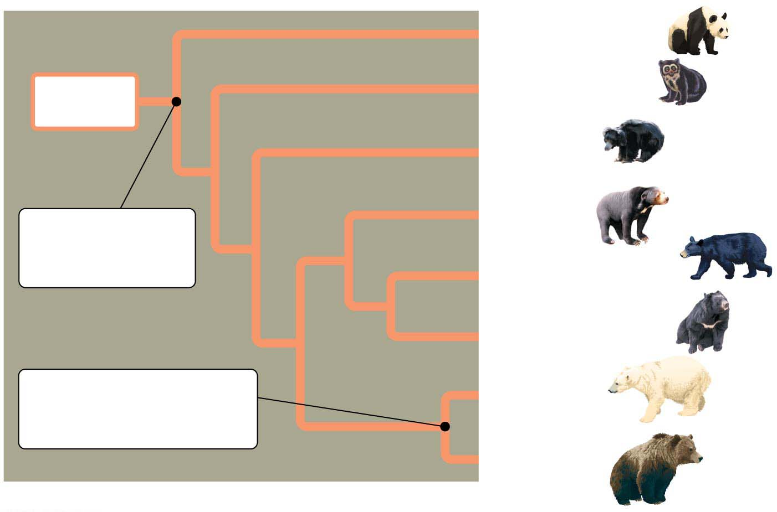
Life evolves.
Each species is one twig of a branching tree of life extending back in time through ancestral species more and more remote.
Species that are very similar, such as the brown bear and polar bear, share a more recent common ancestor that represents a relatively recent branch point on the tree of life.
Giant panda bear
Ancestral
bear
Spectacled bear
Sloth bear
Common
ancestor of all
modern bears
Sun bear
American black bear
Asiatic black bear
Common
ancestor of polar bear
and brown bear
Polar bear
Brown bear
Notes:
16
Student Misconceptions and Concerns
1. Students often believe that Charles Darwin was the first to suggest that life evolves; the early contributions by Greek philosophers and the work of Jean-Baptiste Lamarck may be unappreciated. Consider emphasizing this earlier work in your introduction to Darwin’s contributions.
2. Students often misunderstand the basic process of evolution and instead reflect a Lamarckian point of view. Organisms do not evolve structures deliberately or out of want or need. Individuals do not evolve. Evolution is a passive process in which the environment favors one or more existing variations of a trait already present in a population.
Teaching Tips
1. Many resources related to Charles Darwin are available on the Internet:
a. General evolution resources:
evolution.berkeley.edu
nationalacademies.org/evolution
ncse.com
b. The complete works of Charles Darwin can be found at darwin-online.org.uk/
c. Details of Charles Darwin’s home are located at http://williamcalvin.com/bookshelf/down_hse.htm
2. There are many variations of games that model aspects of natural selection. Here is one that is appropriate for a laboratory exercise. Purchase several bags of dried grocery store beans of diverse sizes and colors. Large lima beans, small white beans, red beans, and black beans are all good options. Consider the beans “food” for the “predatory” students. To begin, randomly distribute (throw) 100 beans of each of four colors onto a green lawn. Allow individual students to collect beans over a set period, perhaps 3 minutes. Then count the total number of each color of bean collected. Assume that the beans remaining undetected (still in the lawn) reproduce by doubling in number. Calculate the number of beans of each color remaining in the field. For the next round, count out the number of each color to add to the lawn so that the new totals on the lawn will double the number of beans that students did not find in the first “generation.” Before each predatory episode, record the total number of each color of beans that have “survived” in the field. Then let your student “predators” out for another round of collection (generation). Repeat the process for at least three or four “generations.” Note what colors of beans are favored by the environment. Ask students to speculate which colors might have been favored during another season or on a parking lot.
3. Many websites devoted to domesticated species can be used to illustrate the variety of forms produced by artificial selection. Those devoted to pigeons, chickens, and dogs have proven to be especially useful.
4. The authors make an analogy between the four bases used to form genes and the 26 letters of the English alphabet used to create words and sentences. One could also make an analogy between the four bases and trains composed of four different types of railroad cars (perhaps an engine, boxcar, tanker, and flatcar). Imagine how many different types of trains one could make using just 100 rail cars of four different types. (The answer is 4¹⁰⁰.)
5. For a chance to add a little math to the biological levels of organization, consider calculating the general scale differences between each level of biological organization. For example, are cells generally 5, 10, 50, or 100 times more massive than organelles? Are organelles generally 5, 10, 50, or 100 times more massive than macromolecules? For some levels of organization, such as ecosystems, communities, and populations, size or scale differences are perhaps less relevant and more problematic to consider. However, at the smaller levels, the sense of scale might enhance an appreciation for levels of biological organization.
6. The U.S. Census Bureau maintains updated population clocks that estimate the U.S. and world populations (www.census.gov/popclock/). If students have a general idea of the human population of the United States, statistics about the number of people affected with a disease or disaster become more significant. For example, the current population of the United States is about 320,000,000 (in 2014). It is currently estimated that at least 1 million people in the United States are infected with HIV. The number of people infected with HIV is impressive and concerning, but not perhaps as meaningful as the realization that this represents about one of every 320 people in the United States. Although the infected people are not evenly distributed among geographic and ethnic groups, if you apply this generality to the enrollments in your classes, the students might better understand the tremendous impact of HIV infection.
Active Lecture Tips
1. Help the class think through the diverse interactions between an organism and its environment. In class, select an organism and have students work in small groups to develop a list of environmental components that interact with the organism. This list should include living and nonliving categories.

Slide 17
The Darwinian View of Life
The evolutionary view of life came into focus in 1859 when Charles Darwin published On the Origin of Species by Means of Natural Selection.
Notes:
17
Student Misconceptions and Concerns
1. Students often believe that Charles Darwin was the first to suggest that life evolves; the early contributions by Greek philosophers and the work of Jean-Baptiste Lamarck may be unappreciated. Consider emphasizing this earlier work in your introduction to Darwin’s contributions.
2. Students often misunderstand the basic process of evolution and instead reflect a Lamarckian point of view. Organisms do not evolve structures deliberately or out of want or need. Individuals do not evolve. Evolution is a passive process in which the environment favors one or more existing variations of a trait already present in a population.
Teaching Tips
1. Many resources related to Charles Darwin are available on the Internet:
a. General evolution resources:
evolution.berkeley.edu
nationalacademies.org/evolution
ncse.com
b. The complete works of Charles Darwin can be found at darwin-online.org.uk/
c. Details of Charles Darwin’s home are located at http://williamcalvin.com/bookshelf/down_hse.htm
2. There are many variations of games that model aspects of natural selection. Here is one that is appropriate for a laboratory exercise. Purchase several bags of dried grocery store beans of diverse sizes and colors. Large lima beans, small white beans, red beans, and black beans are all good options. Consider the beans “food” for the “predatory” students. To begin, randomly distribute (throw) 100 beans of each of four colors onto a green lawn. Allow individual students to collect beans over a set period, perhaps 3 minutes. Then count the total number of each color of bean collected. Assume that the beans remaining undetected (still in the lawn) reproduce by doubling in number. Calculate the number of beans of each color remaining in the field. For the next round, count out the number of each color to add to the lawn so that the new totals on the lawn will double the number of beans that students did not find in the first “generation.” Before each predatory episode, record the total number of each color of beans that have “survived” in the field. Then let your student “predators” out for another round of collection (generation). Repeat the process for at least three or four “generations.” Note what colors of beans are favored by the environment. Ask students to speculate which colors might have been favored during another season or on a parking lot.
3. Many websites devoted to domesticated species can be used to illustrate the variety of forms produced by artificial selection. Those devoted to pigeons, chickens, and dogs have proven to be especially useful.
4. The authors make an analogy between the four bases used to form genes and the 26 letters of the English alphabet used to create words and sentences. One could also make an analogy between the four bases and trains composed of four different types of railroad cars (perhaps an engine, boxcar, tanker, and flatcar). Imagine how many different types of trains one could make using just 100 rail cars of four different types. (The answer is 4¹⁰⁰.)
5. For a chance to add a little math to the biological levels of organization, consider calculating the general scale differences between each level of biological organization. For example, are cells generally 5, 10, 50, or 100 times more massive than organelles? Are organelles generally 5, 10, 50, or 100 times more massive than macromolecules? For some levels of organization, such as ecosystems, communities, and populations, size or scale differences are perhaps less relevant and more problematic to consider. However, at the smaller levels, the sense of scale might enhance an appreciation for levels of biological organization.
6. The U.S. Census Bureau maintains updated population clocks that estimate the U.S. and world populations (www.census.gov/popclock/). If students have a general idea of the human population of the United States, statistics about the number of people affected with a disease or disaster become more significant. For example, the current population of the United States is about 320,000,000 (in 2014). It is currently estimated that at least 1 million people in the United States are infected with HIV. The number of people infected with HIV is impressive and concerning, but not perhaps as meaningful as the realization that this represents about one of every 320 people in the United States. Although the infected people are not evenly distributed among geographic and ethnic groups, if you apply this generality to the enrollments in your classes, the students might better understand the tremendous impact of HIV infection.
Active Lecture Tips
1. Help the class think through the diverse interactions between an organism and its environment. In class, select an organism and have students work in small groups to develop a list of environmental components that interact with the organism. This list should include living and nonliving categories.

Slide 18
The Darwinian View of Life
In the struggle for existence, those individuals with heritable traits best suited to the local environment are more likely to survive and leave the greatest number of healthy offspring.
Darwin’s book developed two main points:
Species living today descended from a succession of ancestral species in what Darwin called “descent with modification,” capturing the duality of life’s
unity (descent) and
diversity (modification).
Natural selection is the mechanism for descent with modification.
Notes:
18
Student Misconceptions and Concerns
1. Students often believe that Charles Darwin was the first to suggest that life evolves; the early contributions by Greek philosophers and the work of Jean-Baptiste Lamarck may be unappreciated. Consider emphasizing this earlier work in your introduction to Darwin’s contributions.
2. Students often misunderstand the basic process of evolution and instead reflect a Lamarckian point of view. Organisms do not evolve structures deliberately or out of want or need. Individuals do not evolve. Evolution is a passive process in which the environment favors one or more existing variations of a trait already present in a population.
Teaching Tips
1. Many resources related to Charles Darwin are available on the Internet:
a. General evolution resources:
evolution.berkeley.edu
nationalacademies.org/evolution
ncse.com
b. The complete works of Charles Darwin can be found at darwin-online.org.uk/
c. Details of Charles Darwin’s home are located at http://williamcalvin.com/bookshelf/down_hse.htm
2. There are many variations of games that model aspects of natural selection. Here is one that is appropriate for a laboratory exercise. Purchase several bags of dried grocery store beans of diverse sizes and colors. Large lima beans, small white beans, red beans, and black beans are all good options. Consider the beans “food” for the “predatory” students. To begin, randomly distribute (throw) 100 beans of each of four colors onto a green lawn. Allow individual students to collect beans over a set period, perhaps 3 minutes. Then count the total number of each color of bean collected. Assume that the beans remaining undetected (still in the lawn) reproduce by doubling in number. Calculate the number of beans of each color remaining in the field. For the next round, count out the number of each color to add to the lawn so that the new totals on the lawn will double the number of beans that students did not find in the first “generation.” Before each predatory episode, record the total number of each color of beans that have “survived” in the field. Then let your student “predators” out for another round of collection (generation). Repeat the process for at least three or four “generations.” Note what colors of beans are favored by the environment. Ask students to speculate which colors might have been favored during another season or on a parking lot.
3. Many websites devoted to domesticated species can be used to illustrate the variety of forms produced by artificial selection. Those devoted to pigeons, chickens, and dogs have proven to be especially useful.
4. The authors make an analogy between the four bases used to form genes and the 26 letters of the English alphabet used to create words and sentences. One could also make an analogy between the four bases and trains composed of four different types of railroad cars (perhaps an engine, boxcar, tanker, and flatcar). Imagine how many different types of trains one could make using just 100 rail cars of four different types. (The answer is 4¹⁰⁰.)
5. For a chance to add a little math to the biological levels of organization, consider calculating the general scale differences between each level of biological organization. For example, are cells generally 5, 10, 50, or 100 times more massive than organelles? Are organelles generally 5, 10, 50, or 100 times more massive than macromolecules? For some levels of organization, such as ecosystems, communities, and populations, size or scale differences are perhaps less relevant and more problematic to consider. However, at the smaller levels, the sense of scale might enhance an appreciation for levels of biological organization.
6. The U.S. Census Bureau maintains updated population clocks that estimate the U.S. and world populations (www.census.gov/popclock/). If students have a general idea of the human population of the United States, statistics about the number of people affected with a disease or disaster become more significant. For example, the current population of the United States is about 320,000,000 (in 2014). It is currently estimated that at least 1 million people in the United States are infected with HIV. The number of people infected with HIV is impressive and concerning, but not perhaps as meaningful as the realization that this represents about one of every 320 people in the United States. Although the infected people are not evenly distributed among geographic and ethnic groups, if you apply this generality to the enrollments in your classes, the students might better understand the tremendous impact of HIV infection.
Active Lecture Tips
1. Help the class think through the diverse interactions between an organism and its environment. In class, select an organism and have students work in small groups to develop a list of environmental components that interact with the organism. This list should include living and nonliving categories.

Slide 19
Antibiotic resistance in bacteria evolves in response to the overuse of antibiotics when dairy and cattle farmers add antibiotics to feed.
The members of the bacteria population will, through random chance, vary in their susceptibility to the antibiotic.
Once the environment changes by the addition of antibiotics,
some bacteria will succumb quickly and die,
while others will tend to survive.
Those bacteria that survive will multiply, producing offspring that will likely inherit the traits that enhance survival.
Notes:
19
Student Misconceptions and Concerns
1. Students often believe that Charles Darwin was the first to suggest that life evolves; the early contributions by Greek philosophers and the work of Jean-Baptiste Lamarck may be unappreciated. Consider emphasizing this earlier work in your introduction to Darwin’s contributions.
2. Students often misunderstand the basic process of evolution and instead reflect a Lamarckian point of view. Organisms do not evolve structures deliberately or out of want or need. Individuals do not evolve. Evolution is a passive process in which the environment favors one or more existing variations of a trait already present in a population.
Teaching Tips
1. Many resources related to Charles Darwin are available on the Internet:
a. General evolution resources:
evolution.berkeley.edu
nationalacademies.org/evolution
ncse.com
b. The complete works of Charles Darwin can be found at darwin-online.org.uk/
c. Details of Charles Darwin’s home are located at http://williamcalvin.com/bookshelf/down_hse.htm
2. There are many variations of games that model aspects of natural selection. Here is one that is appropriate for a laboratory exercise. Purchase several bags of dried grocery store beans of diverse sizes and colors. Large lima beans, small white beans, red beans, and black beans are all good options. Consider the beans “food” for the “predatory” students. To begin, randomly distribute (throw) 100 beans of each of four colors onto a green lawn. Allow individual students to collect beans over a set period, perhaps 3 minutes. Then count the total number of each color of bean collected. Assume that the beans remaining undetected (still in the lawn) reproduce by doubling in number. Calculate the number of beans of each color remaining in the field. For the next round, count out the number of each color to add to the lawn so that the new totals on the lawn will double the number of beans that students did not find in the first “generation.” Before each predatory episode, record the total number of each color of beans that have “survived” in the field. Then let your student “predators” out for another round of collection (generation). Repeat the process for at least three or four “generations.” Note what colors of beans are favored by the environment. Ask students to speculate which colors might have been favored during another season or on a parking lot.
3. Many websites devoted to domesticated species can be used to illustrate the variety of forms produced by artificial selection. Those devoted to pigeons, chickens, and dogs have proven to be especially useful.
4. The authors make an analogy between the four bases used to form genes and the 26 letters of the English alphabet used to create words and sentences. One could also make an analogy between the four bases and trains composed of four different types of railroad cars (perhaps an engine, boxcar, tanker, and flatcar). Imagine how many different types of trains one could make using just 100 rail cars of four different types. (The answer is 4¹⁰⁰.)
5. For a chance to add a little math to the biological levels of organization, consider calculating the general scale differences between each level of biological organization. For example, are cells generally 5, 10, 50, or 100 times more massive than organelles? Are organelles generally 5, 10, 50, or 100 times more massive than macromolecules? For some levels of organization, such as ecosystems, communities, and populations, size or scale differences are perhaps less relevant and more problematic to consider. However, at the smaller levels, the sense of scale might enhance an appreciation for levels of biological organization.
6. The U.S. Census Bureau maintains updated population clocks that estimate the U.S. and world populations (www.census.gov/popclock/). If students have a general idea of the human population of the United States, statistics about the number of people affected with a disease or disaster become more significant. For example, the current population of the United States is about 320,000,000 (in 2014). It is currently estimated that at least 1 million people in the United States are infected with HIV. The number of people infected with HIV is impressive and concerning, but not perhaps as meaningful as the realization that this represents about one of every 320 people in the United States. Although the infected people are not evenly distributed among geographic and ethnic groups, if you apply this generality to the enrollments in your classes, the students might better understand the tremendous impact of HIV infection.
Active Lecture Tips
1. Help the class think through the diverse interactions between an organism and its environment. In class, select an organism and have students work in small groups to develop a list of environmental components that interact with the organism. This list should include living and nonliving categories.

Slide 20
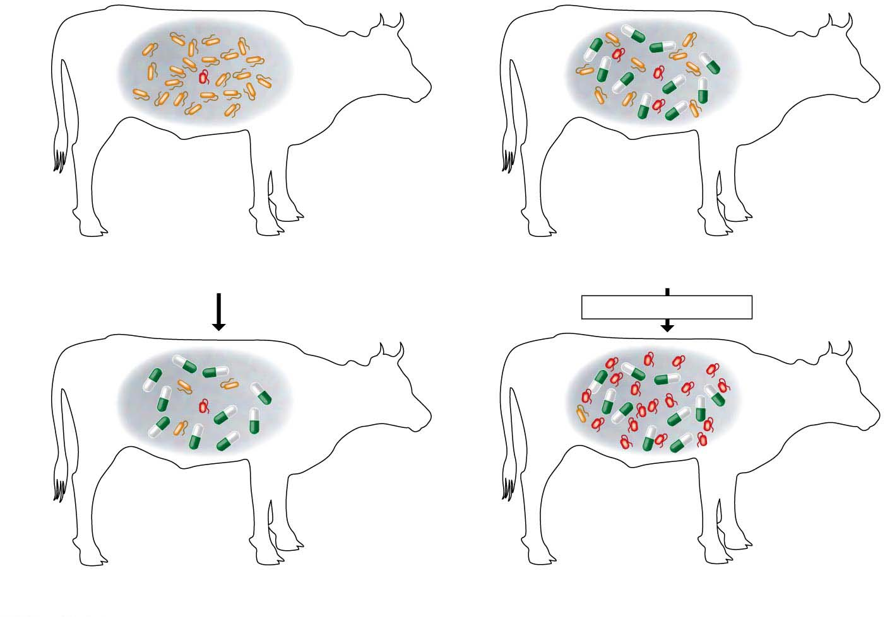
Figure 1.12
Over many bacterial generations, feeding antibiotics to cows may promote the evolution of antibiotic-resistant bacteria that, if transferred to the human food supply, could cause infections that are not susceptible to standard drug treatments.
Bacteria
Population with varied inherited traits
Reproduction of survivors
Antibiotic
added
Many generations
Elimination of individuals with certain traits
Increasing frequency of traits that enhance
survival and reproductive success
Notes:
Figure 1.12 Natural selection in action

Slide 21
Artificial Selection
Artificial selection is the purposeful breeding of domesticated plants and animals by humans.
Humans have customized crop plants through many generations of artificial selection by selecting different parts of the plant to accentuate as food.
Notes:
21
Student Misconceptions and Concerns
1. Students often believe that Charles Darwin was the first to suggest that life evolves; the early contributions by Greek philosophers and the work of Jean-Baptiste Lamarck may be unappreciated. Consider emphasizing this earlier work in your introduction to Darwin’s contributions.
2. Students often misunderstand the basic process of evolution and instead reflect a Lamarckian point of view. Organisms do not evolve structures deliberately or out of want or need. Individuals do not evolve. Evolution is a passive process in which the environment favors one or more existing variations of a trait already present in a population.
Teaching Tips
1. Many resources related to Charles Darwin are available on the Internet:
a. General evolution resources:
evolution.berkeley.edu
nationalacademies.org/evolution
ncse.com
b. The complete works of Charles Darwin can be found at darwin-online.org.uk/
c. Details of Charles Darwin’s home are located at http://williamcalvin.com/bookshelf/down_hse.htm
2. There are many variations of games that model aspects of natural selection. Here is one that is appropriate for a laboratory exercise. Purchase several bags of dried grocery store beans of diverse sizes and colors. Large lima beans, small white beans, red beans, and black beans are all good options. Consider the beans “food” for the “predatory” students. To begin, randomly distribute (throw) 100 beans of each of four colors onto a green lawn. Allow individual students to collect beans over a set period, perhaps 3 minutes. Then count the total number of each color of bean collected. Assume that the beans remaining undetected (still in the lawn) reproduce by doubling in number. Calculate the number of beans of each color remaining in the field. For the next round, count out the number of each color to add to the lawn so that the new totals on the lawn will double the number of beans that students did not find in the first “generation.” Before each predatory episode, record the total number of each color of beans that have “survived” in the field. Then let your student “predators” out for another round of collection (generation). Repeat the process for at least three or four “generations.” Note what colors of beans are favored by the environment. Ask students to speculate which colors might have been favored during another season or on a parking lot.
3. Many websites devoted to domesticated species can be used to illustrate the variety of forms produced by artificial selection. Those devoted to pigeons, chickens, and dogs have proven to be especially useful.
4. The authors make an analogy between the four bases used to form genes and the 26 letters of the English alphabet used to create words and sentences. One could also make an analogy between the four bases and trains composed of four different types of railroad cars (perhaps an engine, boxcar, tanker, and flatcar). Imagine how many different types of trains one could make using just 100 rail cars of four different types. (The answer is 4¹⁰⁰.)
5. For a chance to add a little math to the biological levels of organization, consider calculating the general scale differences between each level of biological organization. For example, are cells generally 5, 10, 50, or 100 times more massive than organelles? Are organelles generally 5, 10, 50, or 100 times more massive than macromolecules? For some levels of organization, such as ecosystems, communities, and populations, size or scale differences are perhaps less relevant and more problematic to consider. However, at the smaller levels, the sense of scale might enhance an appreciation for levels of biological organization.
6. The U.S. Census Bureau maintains updated population clocks that estimate the U.S. and world populations (www.census.gov/popclock/). If students have a general idea of the human population of the United States, statistics about the number of people affected with a disease or disaster become more significant. For example, the current population of the United States is about 320,000,000 (in 2014). It is currently estimated that at least 1 million people in the United States are infected with HIV. The number of people infected with HIV is impressive and concerning, but not perhaps as meaningful as the realization that this represents about one of every 320 people in the United States. Although the infected people are not evenly distributed among geographic and ethnic groups, if you apply this generality to the enrollments in your classes, the students might better understand the tremendous impact of HIV infection.
Active Lecture Tips
1. Help the class think through the diverse interactions between an organism and its environment. In class, select an organism and have students work in small groups to develop a list of environmental components that interact with the organism. This list should include living and nonliving categories.

Slide 22
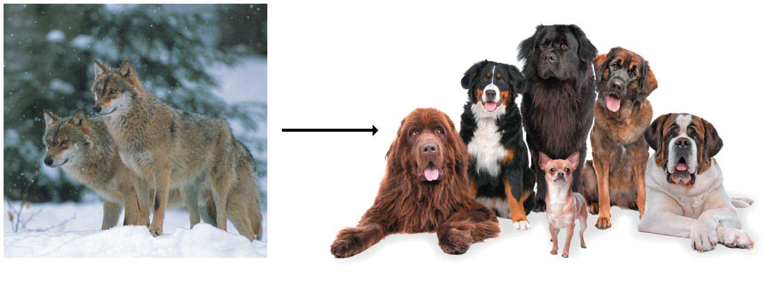
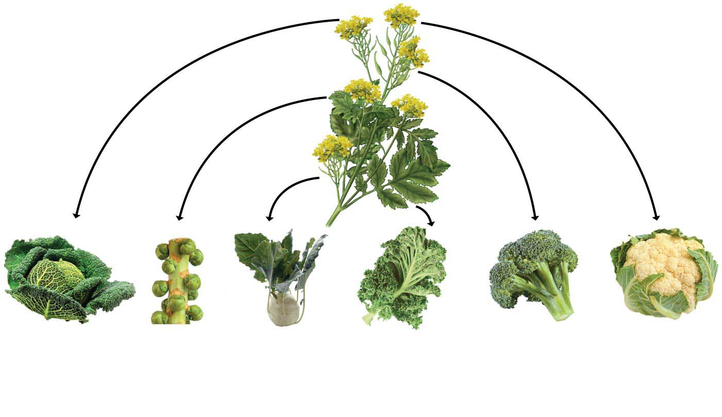
All the vegetables shown in Figure 1.13 have a common ancestor in one species of wild mustard (shown in the center of the figure).
Wild
mustard
Gray wolves
Domesticated dogs
Cabbage from
end buds
Kohlrabi
from
stems
Kale from
leaves
Broccoli
from flowers
and stems
Cauliflower
from flower
clusters
Brussels
sprouts
from side
buds
Notes:
22
Student Misconceptions and Concerns
1. Students often believe that Charles Darwin was the first to suggest that life evolves; the early contributions by Greek philosophers and the work of Jean-Baptiste Lamarck may be unappreciated. Consider emphasizing this earlier work in your introduction to Darwin’s contributions.
2. Students often misunderstand the basic process of evolution and instead reflect a Lamarckian point of view. Organisms do not evolve structures deliberately or out of want or need. Individuals do not evolve. Evolution is a passive process in which the environment favors one or more existing variations of a trait already present in a population.
Teaching Tips
1. Many resources related to Charles Darwin are available on the Internet:
a. General evolution resources:
evolution.berkeley.edu
nationalacademies.org/evolution
ncse.com
b. The complete works of Charles Darwin can be found at darwin-online.org.uk/
c. Details of Charles Darwin’s home are located at http://williamcalvin.com/bookshelf/down_hse.htm
2. There are many variations of games that model aspects of natural selection. Here is one that is appropriate for a laboratory exercise. Purchase several bags of dried grocery store beans of diverse sizes and colors. Large lima beans, small white beans, red beans, and black beans are all good options. Consider the beans “food” for the “predatory” students. To begin, randomly distribute (throw) 100 beans of each of four colors onto a green lawn. Allow individual students to collect beans over a set period, perhaps 3 minutes. Then count the total number of each color of bean collected. Assume that the beans remaining undetected (still in the lawn) reproduce by doubling in number. Calculate the number of beans of each color remaining in the field. For the next round, count out the number of each color to add to the lawn so that the new totals on the lawn will double the number of beans that students did not find in the first “generation.” Before each predatory episode, record the total number of each color of beans that have “survived” in the field. Then let your student “predators” out for another round of collection (generation). Repeat the process for at least three or four “generations.” Note what colors of beans are favored by the environment. Ask students to speculate which colors might have been favored during another season or on a parking lot.
3. Many websites devoted to domesticated species can be used to illustrate the variety of forms produced by artificial selection. Those devoted to pigeons, chickens, and dogs have proven to be especially useful.
4. The authors make an analogy between the four bases used to form genes and the 26 letters of the English alphabet used to create words and sentences. One could also make an analogy between the four bases and trains composed of four different types of railroad cars (perhaps an engine, boxcar, tanker, and flatcar). Imagine how many different types of trains one could make using just 100 rail cars of four different types. (The answer is 4¹⁰⁰.)
5. For a chance to add a little math to the biological levels of organization, consider calculating the general scale differences between each level of biological organization. For example, are cells generally 5, 10, 50, or 100 times more massive than organelles? Are organelles generally 5, 10, 50, or 100 times more massive than macromolecules? For some levels of organization, such as ecosystems, communities, and populations, size or scale differences are perhaps less relevant and more problematic to consider. However, at the smaller levels, the sense of scale might enhance an appreciation for levels of biological organization.
6. The U.S. Census Bureau maintains updated population clocks that estimate the U.S. and world populations (www.census.gov/popclock/). If students have a general idea of the human population of the United States, statistics about the number of people affected with a disease or disaster become more significant. For example, the current population of the United States is about 320,000,000 (in 2014). It is currently estimated that at least 1 million people in the United States are infected with HIV. The number of people infected with HIV is impressive and concerning, but not perhaps as meaningful as the realization that this represents about one of every 320 people in the United States. Although the infected people are not evenly distributed among geographic and ethnic groups, if you apply this generality to the enrollments in your classes, the students might better understand the tremendous impact of HIV infection.
Active Lecture Tips
1. Help the class think through the diverse interactions between an organism and its environment. In class, select an organism and have students work in small groups to develop a list of environmental components that interact with the organism. This list should include living and nonliving categories.

Slide 23
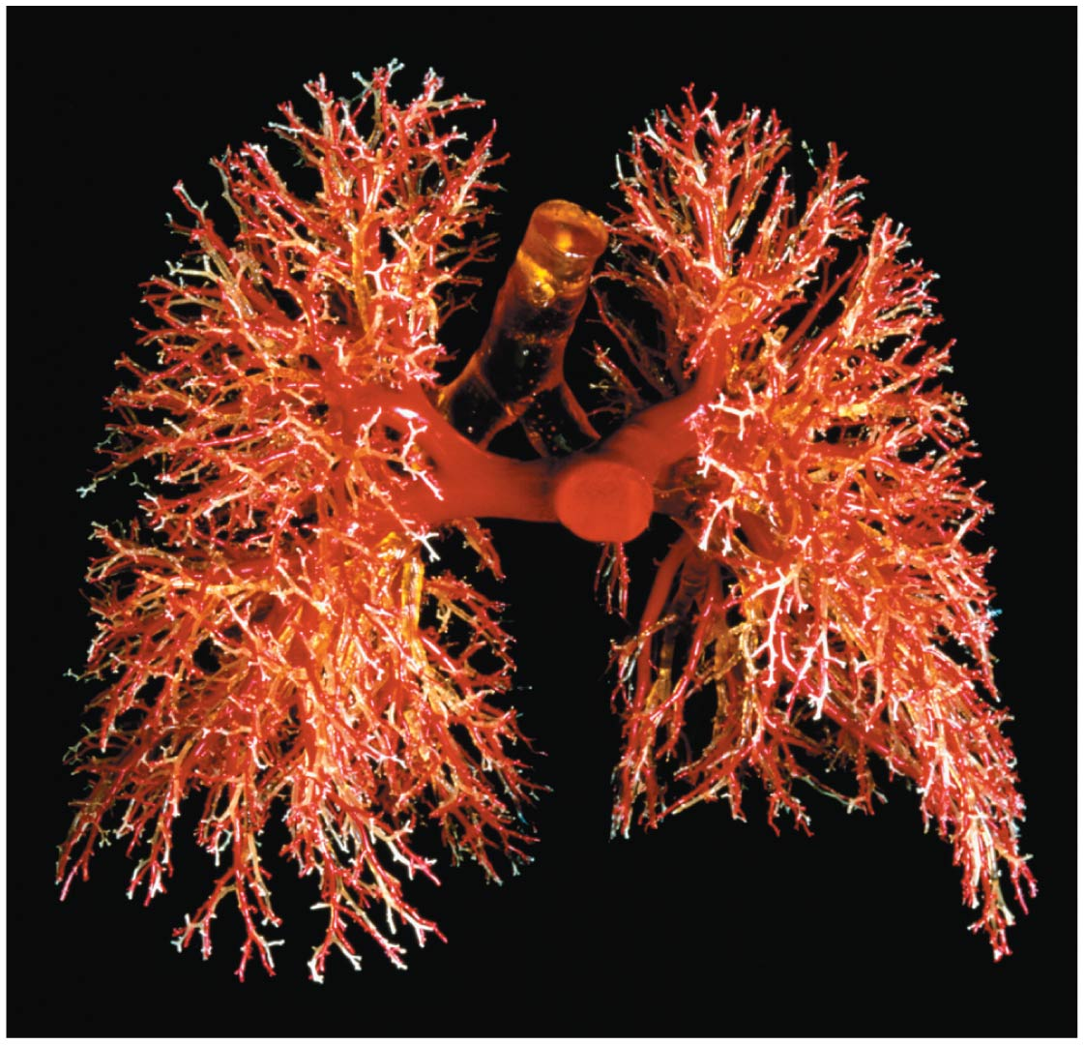
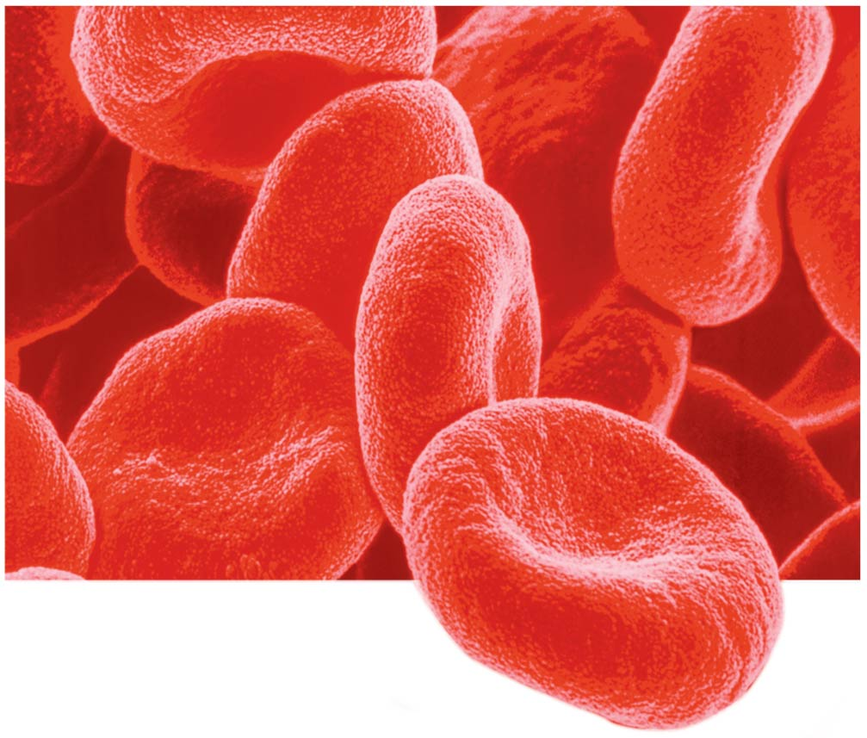
Structure/Function: The Relationship of Structure to Function
Within biological systems, structure (the shape of something) and function (what it does) are often related, with each providing insight into the other.
Notes:
23
Student Misconceptions and Concerns
1. Students often believe that Charles Darwin was the first to suggest that life evolves; the early contributions by Greek philosophers and the work of Jean-Baptiste Lamarck may be unappreciated. Consider emphasizing this earlier work in your introduction to Darwin’s contributions.
2. Students often misunderstand the basic process of evolution and instead reflect a Lamarckian point of view. Organisms do not evolve structures deliberately or out of want or need. Individuals do not evolve. Evolution is a passive process in which the environment favors one or more existing variations of a trait already present in a population.
Teaching Tips
1. Many resources related to Charles Darwin are available on the Internet:
a. General evolution resources:
evolution.berkeley.edu
nationalacademies.org/evolution
ncse.com
b. The complete works of Charles Darwin can be found at darwin-online.org.uk/
c. Details of Charles Darwin’s home are located at http://williamcalvin.com/bookshelf/down_hse.htm
2. There are many variations of games that model aspects of natural selection. Here is one that is appropriate for a laboratory exercise. Purchase several bags of dried grocery store beans of diverse sizes and colors. Large lima beans, small white beans, red beans, and black beans are all good options. Consider the beans “food” for the “predatory” students. To begin, randomly distribute (throw) 100 beans of each of four colors onto a green lawn. Allow individual students to collect beans over a set period, perhaps 3 minutes. Then count the total number of each color of bean collected. Assume that the beans remaining undetected (still in the lawn) reproduce by doubling in number. Calculate the number of beans of each color remaining in the field. For the next round, count out the number of each color to add to the lawn so that the new totals on the lawn will double the number of beans that students did not find in the first “generation.” Before each predatory episode, record the total number of each color of beans that have “survived” in the field. Then let your student “predators” out for another round of collection (generation). Repeat the process for at least three or four “generations.” Note what colors of beans are favored by the environment. Ask students to speculate which colors might have been favored during another season or on a parking lot.
3. Many websites devoted to domesticated species can be used to illustrate the variety of forms produced by artificial selection. Those devoted to pigeons, chickens, and dogs have proven to be especially useful.
4. The authors make an analogy between the four bases used to form genes and the 26 letters of the English alphabet used to create words and sentences. One could also make an analogy between the four bases and trains composed of four different types of railroad cars (perhaps an engine, boxcar, tanker, and flatcar). Imagine how many different types of trains one could make using just 100 rail cars of four different types. (The answer is 4¹⁰⁰.)
5. For a chance to add a little math to the biological levels of organization, consider calculating the general scale differences between each level of biological organization. For example, are cells generally 5, 10, 50, or 100 times more massive than organelles? Are organelles generally 5, 10, 50, or 100 times more massive than macromolecules? For some levels of organization, such as ecosystems, communities, and populations, size or scale differences are perhaps less relevant and more problematic to consider. However, at the smaller levels, the sense of scale might enhance an appreciation for levels of biological organization.
6. The U.S. Census Bureau maintains updated population clocks that estimate the U.S. and world populations (www.census.gov/popclock/). If students have a general idea of the human population of the United States, statistics about the number of people affected with a disease or disaster become more significant. For example, the current population of the United States is about 320,000,000 (in 2014). It is currently estimated that at least 1 million people in the United States are infected with HIV. The number of people infected with HIV is impressive and concerning, but not perhaps as meaningful as the realization that this represents about one of every 320 people in the United States. Although the infected people are not evenly distributed among geographic and ethnic groups, if you apply this generality to the enrollments in your classes, the students might better understand the tremendous impact of HIV infection.
Active Lecture Tips
1. Help the class think through the diverse interactions between an organism and its environment. In class, select an organism and have students work in small groups to develop a list of environmental components that interact with the organism. This list should include living and nonliving categories.

Slide 24
Information Flow
For life’s functions to proceed in an orderly manner, information must be
stored,
transmitted, and
used.
Every cell in your body was created when a previous cell transmitted information (in the form of DNA) to it.
Even your very first cell, the zygote, or fertilized egg, contains information passed on from the previous generation.
Notes:
24
Student Misconceptions and Concerns
1. Students often believe that Charles Darwin was the first to suggest that life evolves; the early contributions by Greek philosophers and the work of Jean-Baptiste Lamarck may be unappreciated. Consider emphasizing this earlier work in your introduction to Darwin’s contributions.
2. Students often misunderstand the basic process of evolution and instead reflect a Lamarckian point of view. Organisms do not evolve structures deliberately or out of want or need. Individuals do not evolve. Evolution is a passive process in which the environment favors one or more existing variations of a trait already present in a population.
Teaching Tips
1. Many resources related to Charles Darwin are available on the Internet:
a. General evolution resources:
evolution.berkeley.edu
nationalacademies.org/evolution
ncse.com
b. The complete works of Charles Darwin can be found at darwin-online.org.uk/
c. Details of Charles Darwin’s home are located at http://williamcalvin.com/bookshelf/down_hse.htm
2. There are many variations of games that model aspects of natural selection. Here is one that is appropriate for a laboratory exercise. Purchase several bags of dried grocery store beans of diverse sizes and colors. Large lima beans, small white beans, red beans, and black beans are all good options. Consider the beans “food” for the “predatory” students. To begin, randomly distribute (throw) 100 beans of each of four colors onto a green lawn. Allow individual students to collect beans over a set period, perhaps 3 minutes. Then count the total number of each color of bean collected. Assume that the beans remaining undetected (still in the lawn) reproduce by doubling in number. Calculate the number of beans of each color remaining in the field. For the next round, count out the number of each color to add to the lawn so that the new totals on the lawn will double the number of beans that students did not find in the first “generation.” Before each predatory episode, record the total number of each color of beans that have “survived” in the field. Then let your student “predators” out for another round of collection (generation). Repeat the process for at least three or four “generations.” Note what colors of beans are favored by the environment. Ask students to speculate which colors might have been favored during another season or on a parking lot.
3. Many websites devoted to domesticated species can be used to illustrate the variety of forms produced by artificial selection. Those devoted to pigeons, chickens, and dogs have proven to be especially useful.
4. The authors make an analogy between the four bases used to form genes and the 26 letters of the English alphabet used to create words and sentences. One could also make an analogy between the four bases and trains composed of four different types of railroad cars (perhaps an engine, boxcar, tanker, and flatcar). Imagine how many different types of trains one could make using just 100 rail cars of four different types. (The answer is 4¹⁰⁰.)
5. For a chance to add a little math to the biological levels of organization, consider calculating the general scale differences between each level of biological organization. For example, are cells generally 5, 10, 50, or 100 times more massive than organelles? Are organelles generally 5, 10, 50, or 100 times more massive than macromolecules? For some levels of organization, such as ecosystems, communities, and populations, size or scale differences are perhaps less relevant and more problematic to consider. However, at the smaller levels, the sense of scale might enhance an appreciation for levels of biological organization.
6. The U.S. Census Bureau maintains updated population clocks that estimate the U.S. and world populations (www.census.gov/popclock/). If students have a general idea of the human population of the United States, statistics about the number of people affected with a disease or disaster become more significant. For example, the current population of the United States is about 320,000,000 (in 2014). It is currently estimated that at least 1 million people in the United States are infected with HIV. The number of people infected with HIV is impressive and concerning, but not perhaps as meaningful as the realization that this represents about one of every 320 people in the United States. Although the infected people are not evenly distributed among geographic and ethnic groups, if you apply this generality to the enrollments in your classes, the students might better understand the tremendous impact of HIV infection.
Active Lecture Tips
1. Help the class think through the diverse interactions between an organism and its environment. In class, select an organism and have students work in small groups to develop a list of environmental components that interact with the organism. This list should include living and nonliving categories.

Slide 25
Energy Transformations: Pathways That Transform Energy and Matter
Various cellular activities of life are work, such as movement, growth, and reproduction, and work requires energy.
Life is made possible by
the input of energy, primarily from the sun, and
the transformation of energy from one form to another.
Within all living cells, a vast network of interconnected chemical reactions (collectively referred to as metabolism) continually converts energy from one form to another as matter is recycled.
Notes:
25
Student Misconceptions and Concerns
1. Students often believe that Charles Darwin was the first to suggest that life evolves; the early contributions by Greek philosophers and the work of Jean-Baptiste Lamarck may be unappreciated. Consider emphasizing this earlier work in your introduction to Darwin’s contributions.
2. Students often misunderstand the basic process of evolution and instead reflect a Lamarckian point of view. Organisms do not evolve structures deliberately or out of want or need. Individuals do not evolve. Evolution is a passive process in which the environment favors one or more existing variations of a trait already present in a population.
Teaching Tips
1. Many resources related to Charles Darwin are available on the Internet:
a. General evolution resources:
evolution.berkeley.edu
nationalacademies.org/evolution
ncse.com
b. The complete works of Charles Darwin can be found at darwin-online.org.uk/
c. Details of Charles Darwin’s home are located at http://williamcalvin.com/bookshelf/down_hse.htm
2. There are many variations of games that model aspects of natural selection. Here is one that is appropriate for a laboratory exercise. Purchase several bags of dried grocery store beans of diverse sizes and colors. Large lima beans, small white beans, red beans, and black beans are all good options. Consider the beans “food” for the “predatory” students. To begin, randomly distribute (throw) 100 beans of each of four colors onto a green lawn. Allow individual students to collect beans over a set period, perhaps 3 minutes. Then count the total number of each color of bean collected. Assume that the beans remaining undetected (still in the lawn) reproduce by doubling in number. Calculate the number of beans of each color remaining in the field. For the next round, count out the number of each color to add to the lawn so that the new totals on the lawn will double the number of beans that students did not find in the first “generation.” Before each predatory episode, record the total number of each color of beans that have “survived” in the field. Then let your student “predators” out for another round of collection (generation). Repeat the process for at least three or four “generations.” Note what colors of beans are favored by the environment. Ask students to speculate which colors might have been favored during another season or on a parking lot.
3. Many websites devoted to domesticated species can be used to illustrate the variety of forms produced by artificial selection. Those devoted to pigeons, chickens, and dogs have proven to be especially useful.
4. The authors make an analogy between the four bases used to form genes and the 26 letters of the English alphabet used to create words and sentences. One could also make an analogy between the four bases and trains composed of four different types of railroad cars (perhaps an engine, boxcar, tanker, and flatcar). Imagine how many different types of trains one could make using just 100 rail cars of four different types. (The answer is 4¹⁰⁰.)
5. For a chance to add a little math to the biological levels of organization, consider calculating the general scale differences between each level of biological organization. For example, are cells generally 5, 10, 50, or 100 times more massive than organelles? Are organelles generally 5, 10, 50, or 100 times more massive than macromolecules? For some levels of organization, such as ecosystems, communities, and populations, size or scale differences are perhaps less relevant and more problematic to consider. However, at the smaller levels, the sense of scale might enhance an appreciation for levels of biological organization.
6. The U.S. Census Bureau maintains updated population clocks that estimate the U.S. and world populations (www.census.gov/popclock/). If students have a general idea of the human population of the United States, statistics about the number of people affected with a disease or disaster become more significant. For example, the current population of the United States is about 320,000,000 (in 2014). It is currently estimated that at least 1 million people in the United States are infected with HIV. The number of people infected with HIV is impressive and concerning, but not perhaps as meaningful as the realization that this represents about one of every 320 people in the United States. Although the infected people are not evenly distributed among geographic and ethnic groups, if you apply this generality to the enrollments in your classes, the students might better understand the tremendous impact of HIV infection.
Active Lecture Tips
1. Help the class think through the diverse interactions between an organism and its environment. In class, select an organism and have students work in small groups to develop a list of environmental components that interact with the organism. This list should include living and nonliving categories.

Slide 26
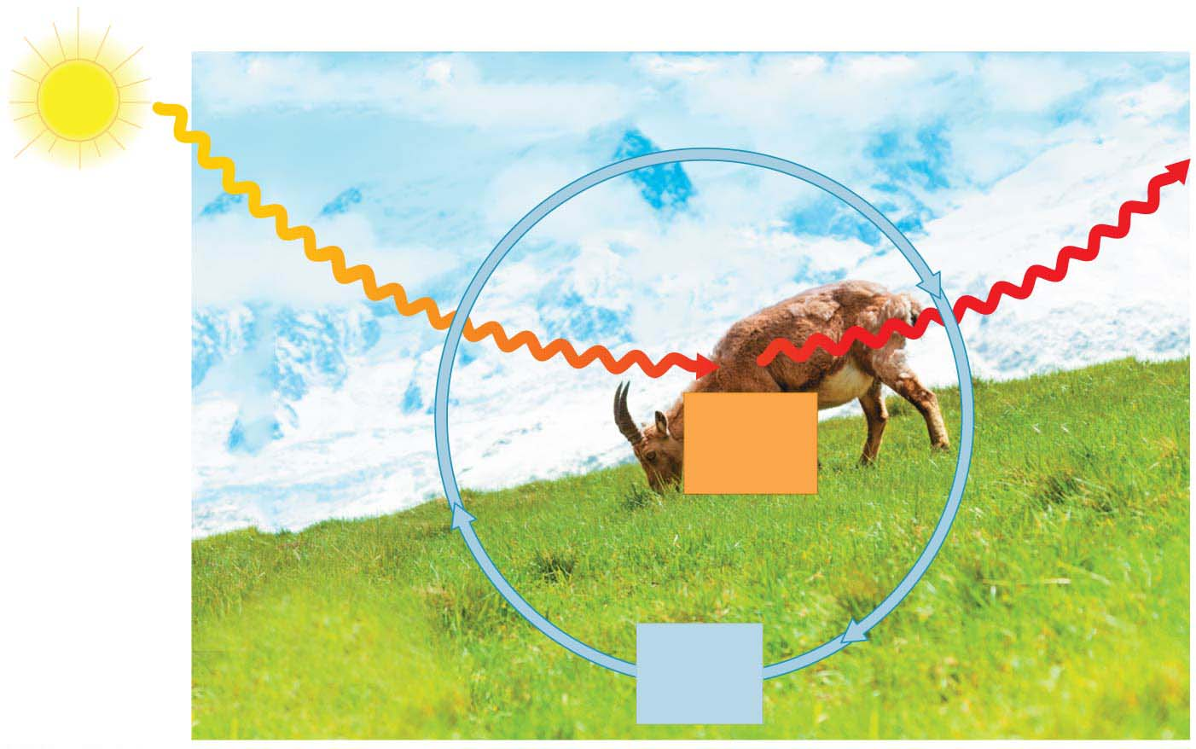
Figure 1.19
Inflow
of light
energy
ECOSYSTEM
Outflow
of heat
energy
Consumers
(animals)
Chemical
energy
(food)
Producers
(plants and other
photosynthetic
organisms)
Decomposers
(in soil)
Cycling
of
nutrients
Notes:
Figure 1.19 Nutrient and energy flow in an ecosystem

Slide 27
Interconnections within Biological Systems
The study of life extends
from the microscopic scale of the molecules and cells that make up organisms
to the global scale of the entire living planet.
Biologists are investigating life at its many levels,
from the interactions within the biosphere
to the molecular machinery within cells.
Notes:
27
Student Misconceptions and Concerns
1. Students often believe that Charles Darwin was the first to suggest that life evolves; the early contributions by Greek philosophers and the work of Jean-Baptiste Lamarck may be unappreciated. Consider emphasizing this earlier work in your introduction to Darwin’s contributions.
2. Students often misunderstand the basic process of evolution and instead reflect a Lamarckian point of view. Organisms do not evolve structures deliberately or out of want or need. Individuals do not evolve. Evolution is a passive process in which the environment favors one or more existing variations of a trait already present in a population.
Teaching Tips
1. Many resources related to Charles Darwin are available on the Internet:
a. General evolution resources:
evolution.berkeley.edu
nationalacademies.org/evolution
ncse.com
b. The complete works of Charles Darwin can be found at darwin-online.org.uk/
c. Details of Charles Darwin’s home are located at http://williamcalvin.com/bookshelf/down_hse.htm
2. There are many variations of games that model aspects of natural selection. Here is one that is appropriate for a laboratory exercise. Purchase several bags of dried grocery store beans of diverse sizes and colors. Large lima beans, small white beans, red beans, and black beans are all good options. Consider the beans “food” for the “predatory” students. To begin, randomly distribute (throw) 100 beans of each of four colors onto a green lawn. Allow individual students to collect beans over a set period, perhaps 3 minutes. Then count the total number of each color of bean collected. Assume that the beans remaining undetected (still in the lawn) reproduce by doubling in number. Calculate the number of beans of each color remaining in the field. For the next round, count out the number of each color to add to the lawn so that the new totals on the lawn will double the number of beans that students did not find in the first “generation.” Before each predatory episode, record the total number of each color of beans that have “survived” in the field. Then let your student “predators” out for another round of collection (generation). Repeat the process for at least three or four “generations.” Note what colors of beans are favored by the environment. Ask students to speculate which colors might have been favored during another season or on a parking lot.
3. Many websites devoted to domesticated species can be used to illustrate the variety of forms produced by artificial selection. Those devoted to pigeons, chickens, and dogs have proven to be especially useful.
4. The authors make an analogy between the four bases used to form genes and the 26 letters of the English alphabet used to create words and sentences. One could also make an analogy between the four bases and trains composed of four different types of railroad cars (perhaps an engine, boxcar, tanker, and flatcar). Imagine how many different types of trains one could make using just 100 rail cars of four different types. (The answer is 4¹⁰⁰.)
5. For a chance to add a little math to the biological levels of organization, consider calculating the general scale differences between each level of biological organization. For example, are cells generally 5, 10, 50, or 100 times more massive than organelles? Are organelles generally 5, 10, 50, or 100 times more massive than macromolecules? For some levels of organization, such as ecosystems, communities, and populations, size or scale differences are perhaps less relevant and more problematic to consider. However, at the smaller levels, the sense of scale might enhance an appreciation for levels of biological organization.
6. The U.S. Census Bureau maintains updated population clocks that estimate the U.S. and world populations (www.census.gov/popclock/). If students have a general idea of the human population of the United States, statistics about the number of people affected with a disease or disaster become more significant. For example, the current population of the United States is about 320,000,000 (in 2014). It is currently estimated that at least 1 million people in the United States are infected with HIV. The number of people infected with HIV is impressive and concerning, but not perhaps as meaningful as the realization that this represents about one of every 320 people in the United States. Although the infected people are not evenly distributed among geographic and ethnic groups, if you apply this generality to the enrollments in your classes, the students might better understand the tremendous impact of HIV infection.
Active Lecture Tips
1. Help the class think through the diverse interactions between an organism and its environment. In class, select an organism and have students work in small groups to develop a list of environmental components that interact with the organism. This list should include living and nonliving categories.

Slide 28
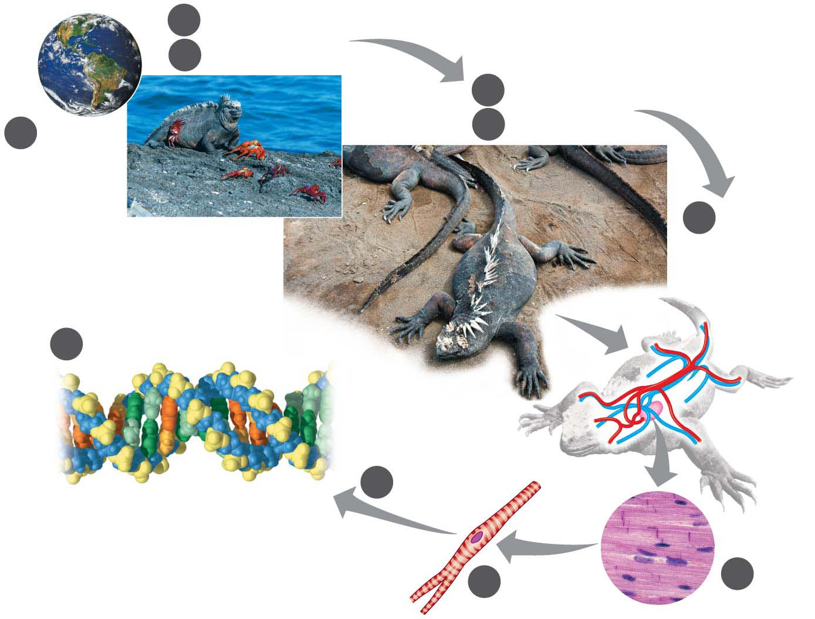
Figure 1.20-s3
2
Ecosystems생태계
3
Communities군집
4
Populations개체군
1
5
Organisms
Biosphere
생물권
6
Organ
Systems
and
Organs
10
Molecules and Atoms
9
Organelles
Atom
Nucleus
8
Cells
7
Tissues
Notes:
Figure 1.20-s3 Zooming in on life (step 3)

